Slide 1

AUTOMATION TESTING- MINI PROJECT
Under Guidance of Mrs. Vaishali Sonanis Mam.

Slide 2
Introduction :
eBay is a global e-commerce corporation that facilitates consumer-to-consumer and business-to-consumer sales through its online marketplace .
The platform is a leader in online auctions and shopping, enabling people and businesses to buy and sell a wide variety of goods and services worldwide. It's a key player in the e-commerce industry, connecting millions of buyers and sellers daily.

Slide 3
Overview
Buying on eBay:
Search for Items: Use search bar or browse categories; filter by price, condition, etc.
Choose a Listing: Check item details, photos, and seller info.
Two Ways to Buy:
Buy It Now: Instant purchase at fixed price.
Auction: Place bids; highest bidder wins.
Checkout & Payment: Pay via card, PayPal, etc.
Shipping & Delivery: Seller ships item; track delivery in your account.

Slide 4
Overview
Selling on eBay:
Create a Listing:
Write clear title & description.
Upload quality photos.
Set price (fixed or auction).
Choose shipping method & cost.
Manage Listing: Monitor activity and respond to buyers.
Complete the Sale:
Receive payment.
Package and ship item.
Provide tracking info.
Receive Feedback: Buyers leave reviews to build your seller reputation.

Slide 5
Responsibilities
To analyse modules, sub-module and tasks
Review the test cases
Execute all the test cases.
Create defect report.
Create test analysis report

Slide 6
Project overview
Modules Tested = 7
Test Cases executed = 10
Defects found = 2

Slide 7
Modules
Module 1 : Sign in TEST
Checked LOGIN functionalities on Sign in page which included personal info as email
, password.
Module 2 : MULTIPLE SEARCH FUNCTIONALITY TEST
Checked functionalities OF SEARCH BUTTON USING MULTIPLE SEARCHES .
Module 3 : ADDING AND DELETING FROM CART
Checked all the functionalities USING TO SEARCH IN page TO ADD itemS AND DELETING FROM THE CART USING Add to cart button AND REMOVE BUTTON FOR DELETING.
Notes:
Module 1: Signn in page
Checked all the functionalities on Sign in page which included personal info as email
address, password
Module 2: Women page
Checked all the functionalities on Women page which included item details, Quantity, Filters,compare button,Add to cart button,product info,grid,list button
Module 3: Tshirt page
Checked all the functionalities on T-Shirt page which included item details, Quantity, Filters,compare button,Add to cart button,product info,grid,list button
Module 4: All Buttons and Drop Down Arrow :
team checked if all the buttons and drop down arrows of different fields are functioning properly or not

Slide 8
Module 4 : CHANGE ADDRESS AND NAME IN PROFILE
checked if all the buttons LIKE EDIT ,SAVE AND SUBMIT OF different fields IN THE ACCOUNT SETTINGS-> PROFILE UPDATE PAGE are functioning properly or not.
Module 5 : SHOPPING BY CATEGORY
Checked WHETHERING IT’S showING all available SUB-CATEGORIES OF products on screen WHEN USING SHOP BY category LIKE ELECTRONICS,ETC….USING MOUSE OVER ACTIONS
Module 6 : SHOPPING BY ALL CATEGORIES
CheckED WHETHER THE SHOP BY ALL CATEGORIES IS WORKING BY USING SEARCH OPTION.
Module 7 : LANGUAGE CHANGE TEST
CHEcked if the language change setting is working or not using country site change
button at the bottom of the page.

Slide 9
Defects
While running a testcase at certain point some fields are not working as it is expected which is nothing but a defect, so we have created a Defect report on those defects.

Slide 10
Defect identifier :- B_001
Ø Defect summary :- SEARCH filed accepting wrong format(Allowing only special characters ) and redirecting to all categories
Ø Test Id :- TC_010
Ø Test case name :- TC_Multiple SEARCH
Module name :- Search
Reproducible :- 1)Enter only special characters in search bar
2) we can Observe the result is showing for soph by all categories
3) It should show a message that we need to check our input or something else but it isn’t.
Ø Severity :- low
Ø Priority :- low
Ø Raised by :- g.nasir hussain
Ø Assigned to :- developer Team lead
Ø Date of assignment :-18/8/2025
Ø Status :- pending
Ø Snap shots :-
Ø Fixed by :- developer
Ø Date of fixing :-

Slide 11
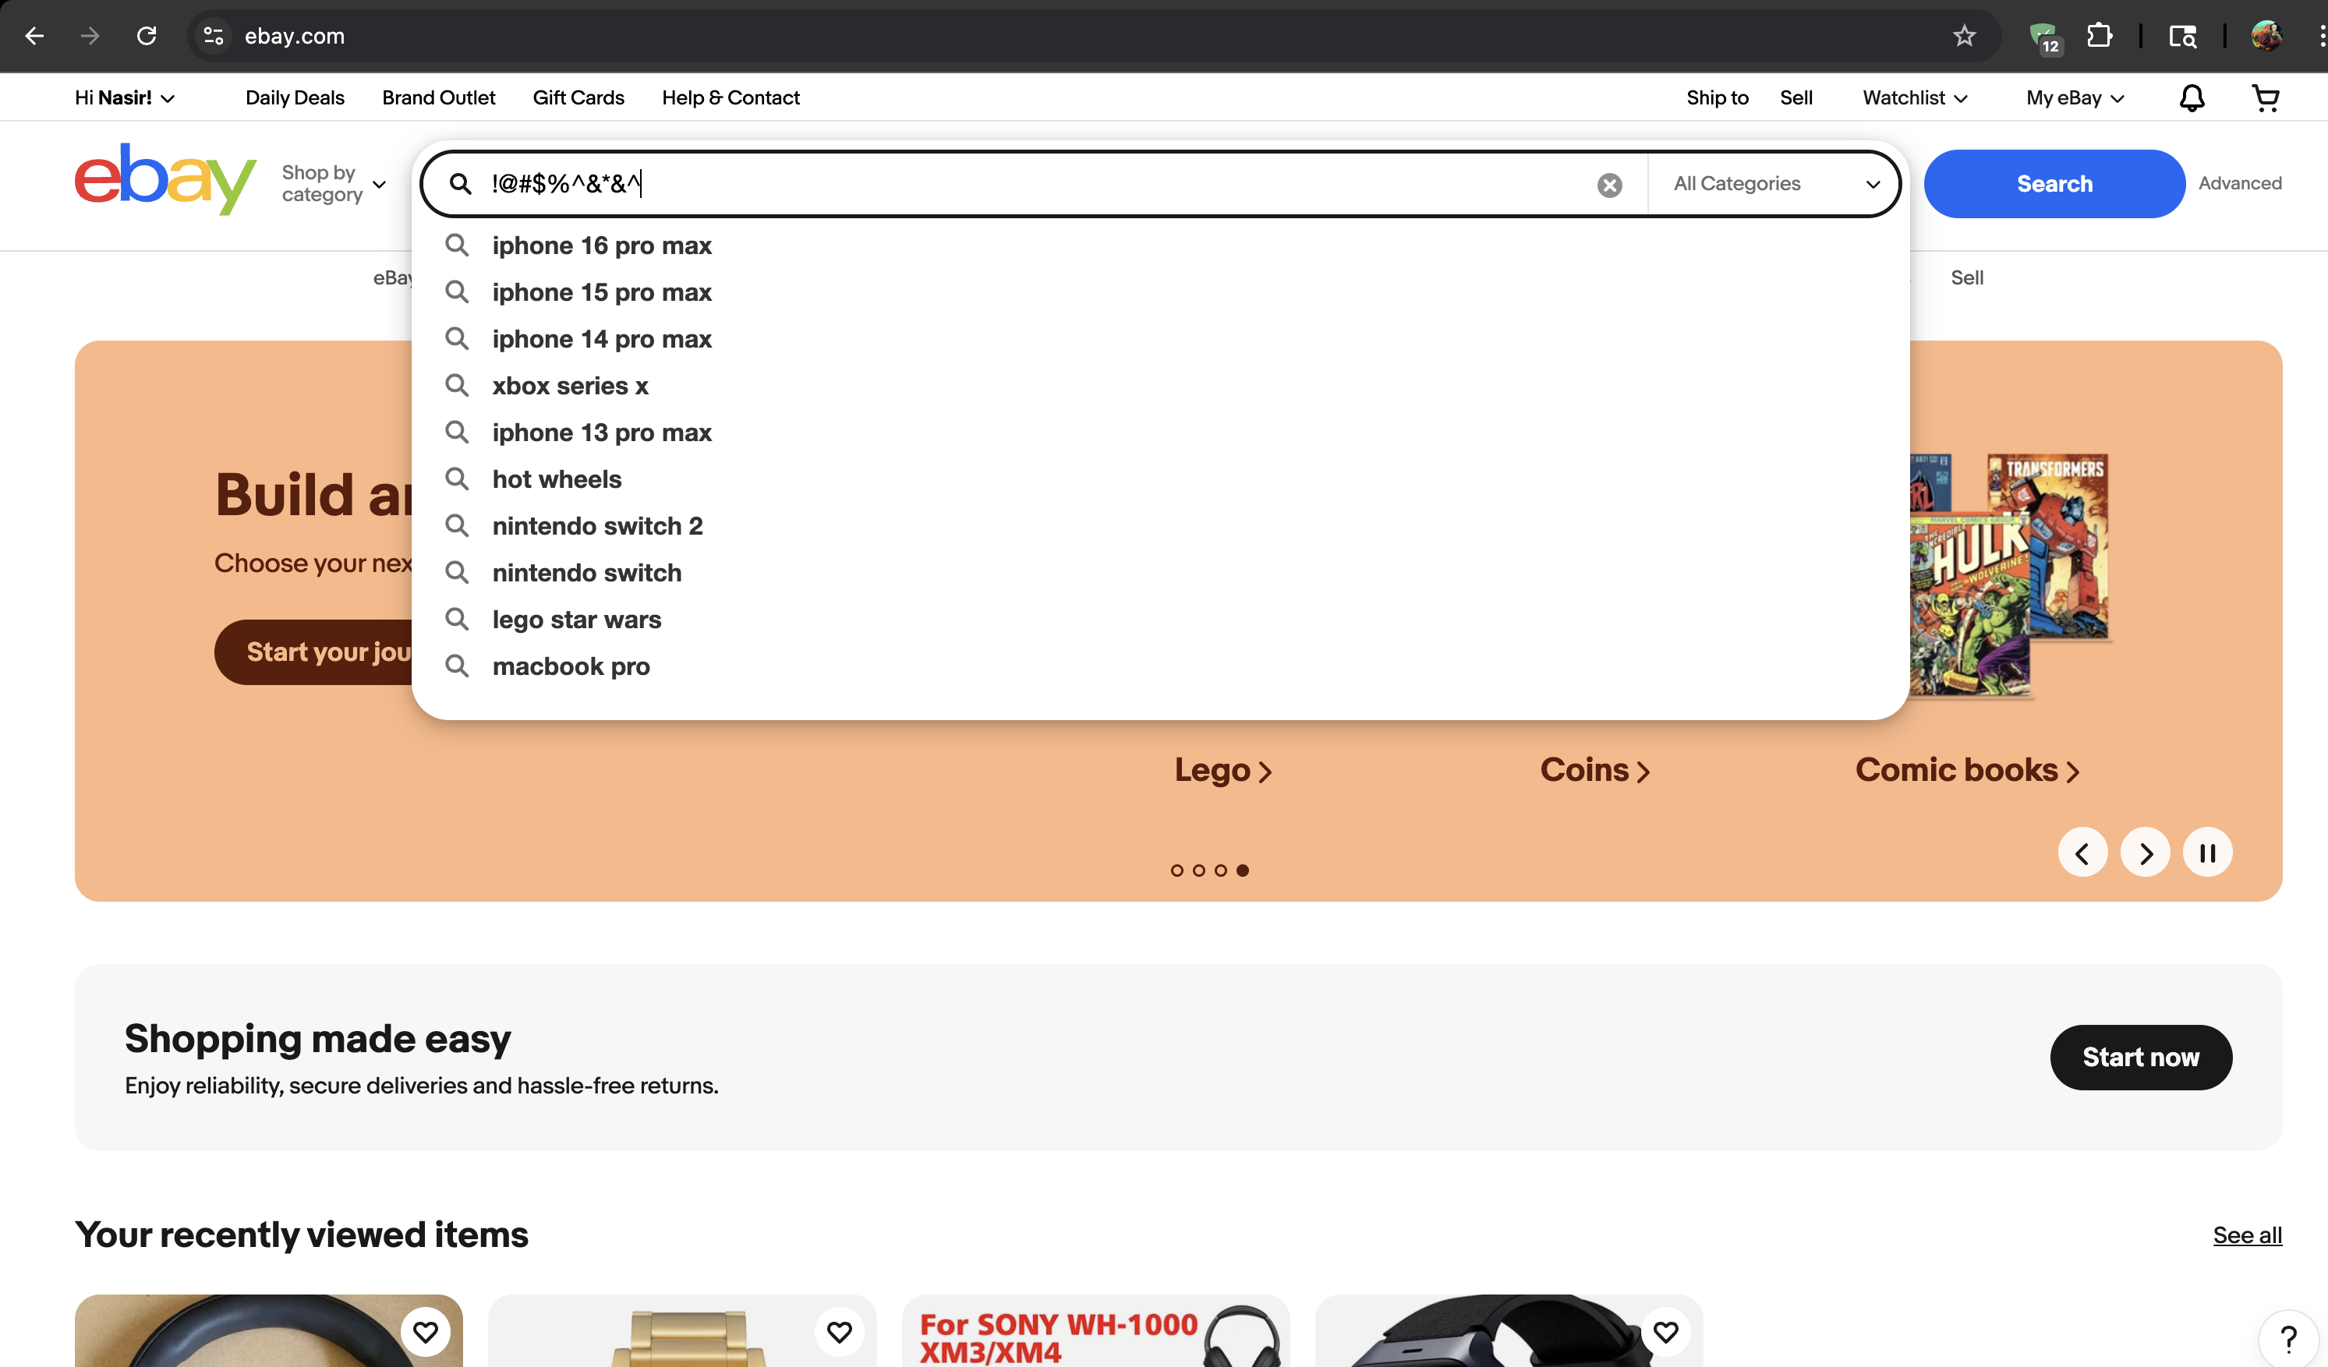
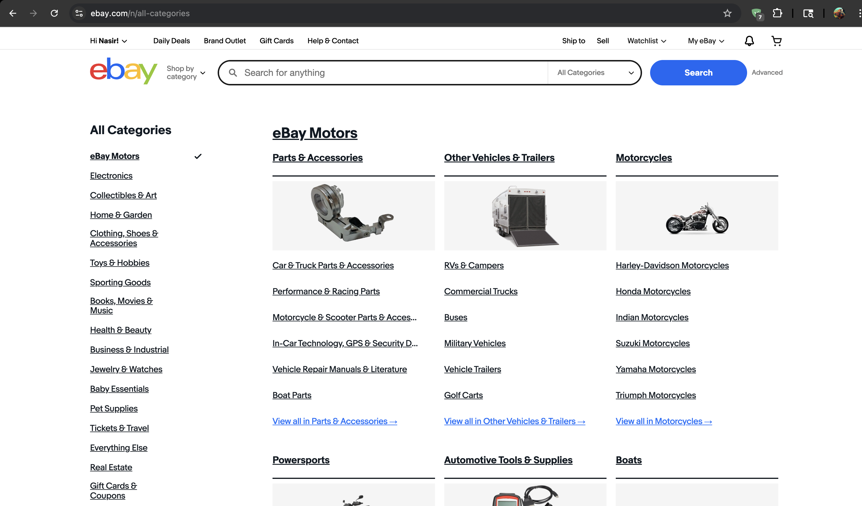

Slide 12
Defect identifier :- B_002
Defect summary :- Donation preferences settings are not available
Ø Test Id :- TC_014
Ø Test case name :- TC_Account_Settigs
Ø Module name :- Account settings
Ø Reproducible :- 1) Go to account settings and click on donation preferences
2). Click on settings under donation preferences
3) we can see that there are no settings available for us.
Ø Severity :- low
Ø Priority :- medium
Ø Raised by :- g.nasir hussain
Ø Assigned to :- developer Team lead
Ø Date of assignment :-
Ø Status :- pending
Ø Snap shots :-
Ø Fixed by :- developer
Ø Date of fixing :-

Slide 13
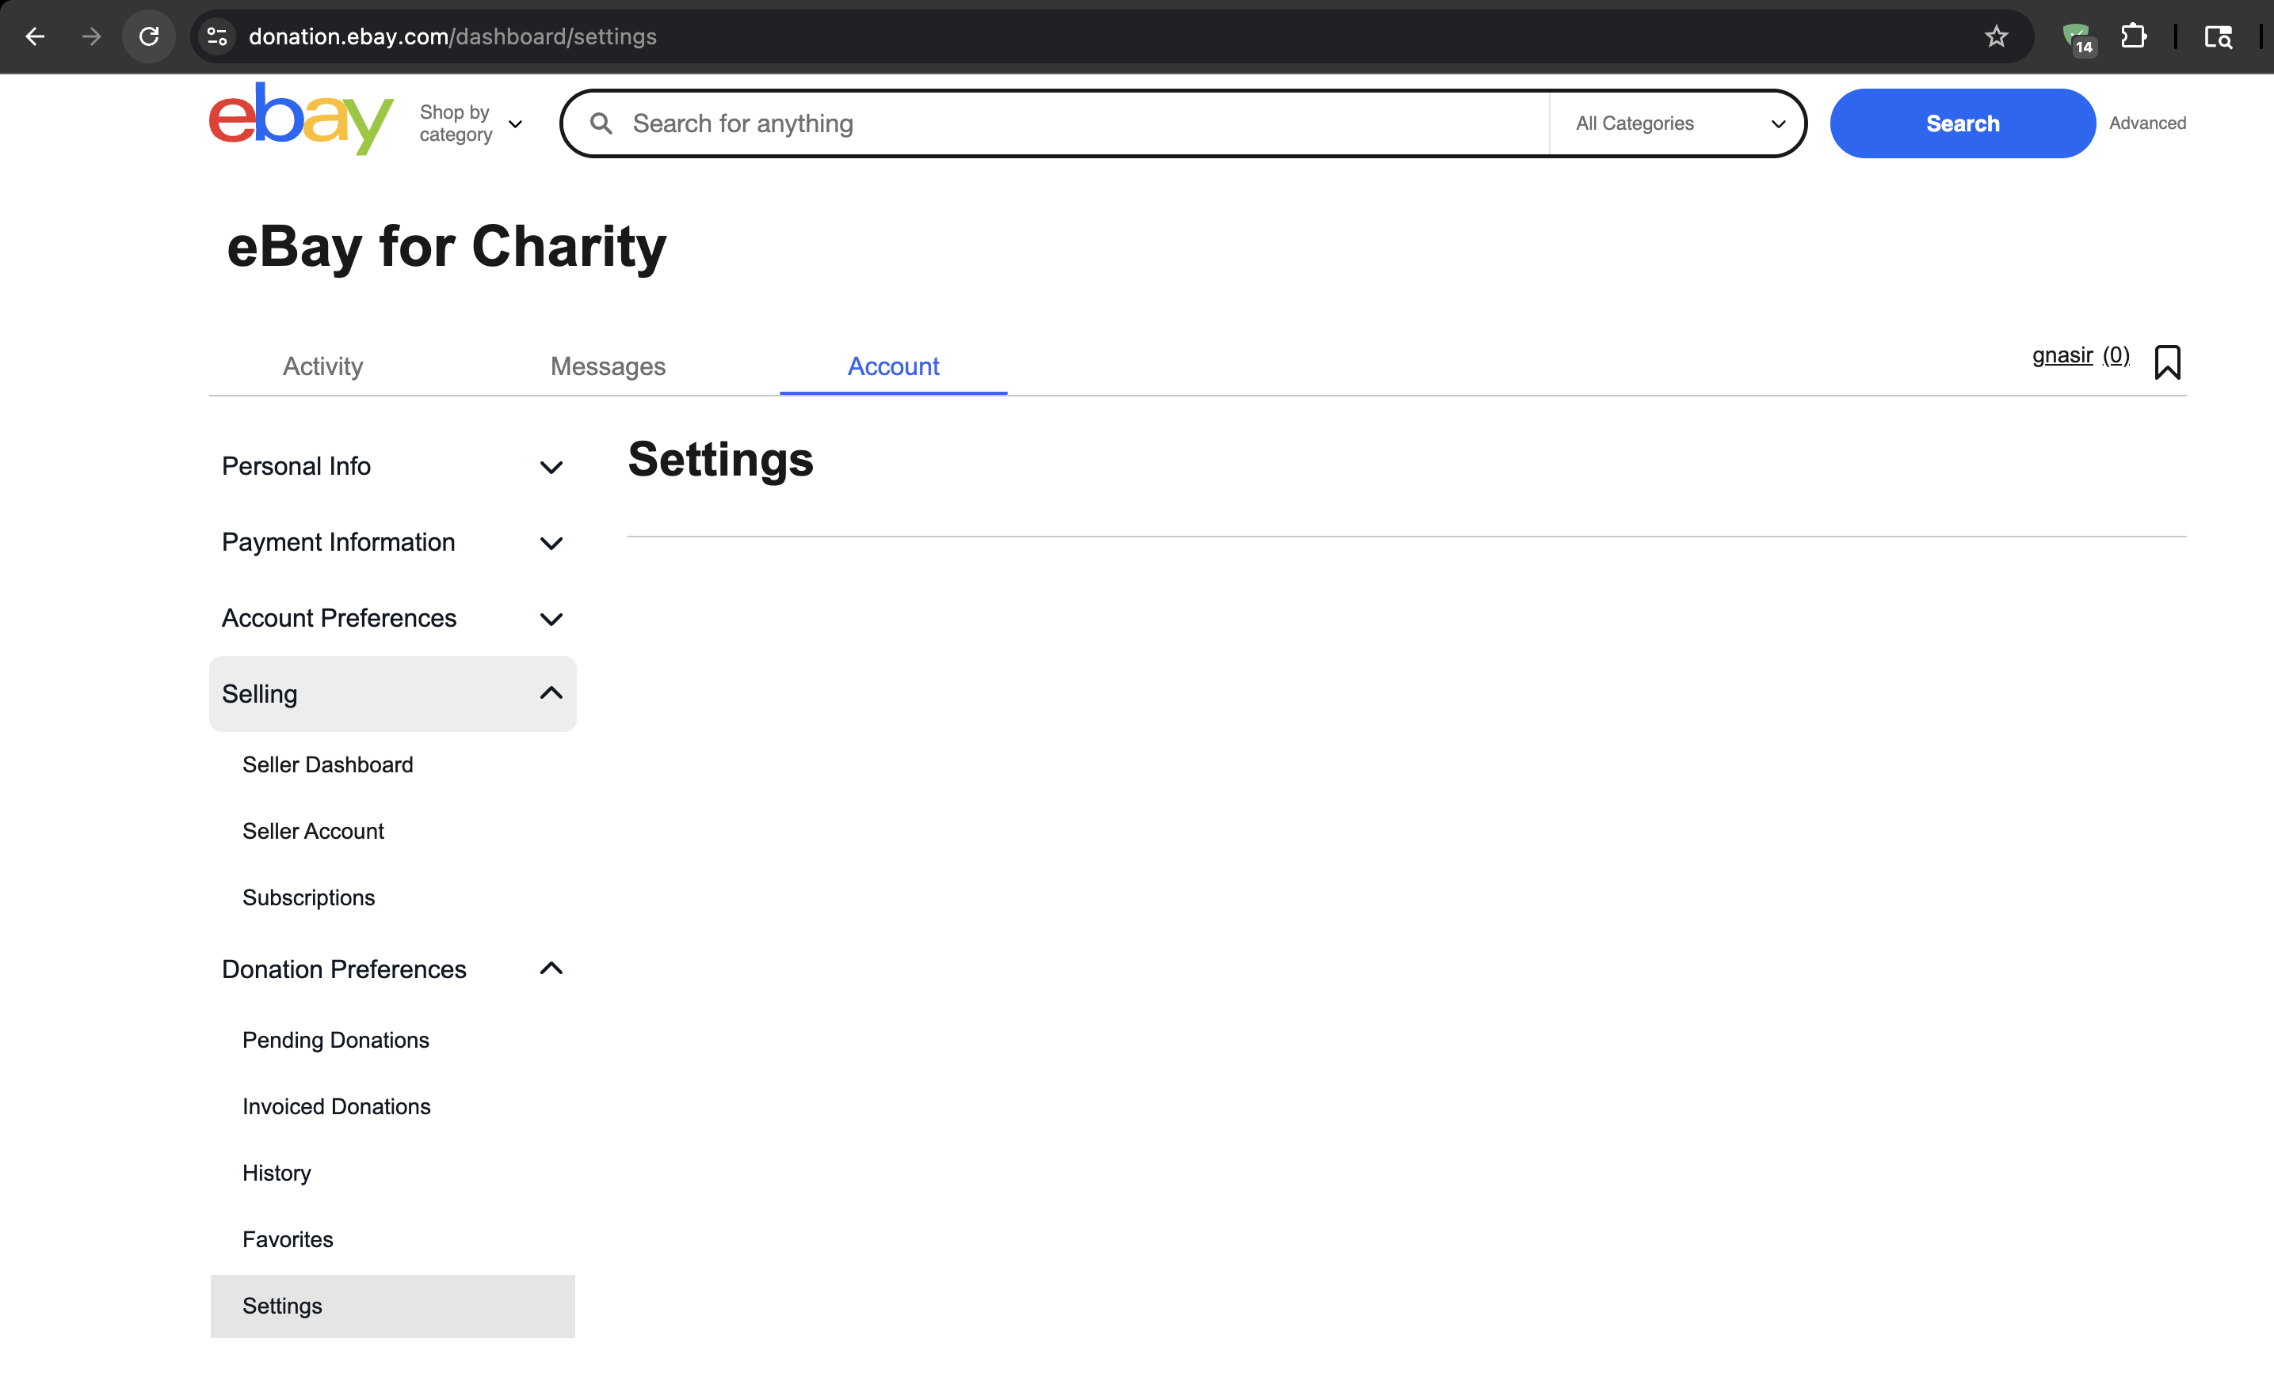

Slide 14
Challenges
While testing ebay website which contains huge data we faced some challenges about:
Sometimes in certain browsers its asking to for captch verification which was breaking our automation flow.
After submitting password it may ask for passkeys storing which throws a popup alert
where we couldn’t inspect that to automate that, which can lead to failing of test case.

Slide 15
Experience
Because of lot of communication And discussion with the team lead it helped me to write taste cases in easy way.
TESTNG Helped to find out in which part or test error was occurring
Data provider made entering negative testcases simpler.
Made testing easy because of automation of the modules.
Manual testing needs strong observation and in that we had to apply all possibilities in test cases.

Slide 16
Thank You!!!
Vaishali Mam For Guiding Us through out the Project.
By:- G.Nasir Hussain

